Slide 1
Abstract Factory

Slide 2
Definition
A creational design pattern that provides an interface for creating families of related or dependent objects without specifying their concrete classes.
Use cases
- Allows you to create families of related objects without specifying a concrete class
- Use when you have many objects that can be addes, or changed dynamically during runtime
- You can model anything you can imagine and have those object interact through common interfaces

Slide 3

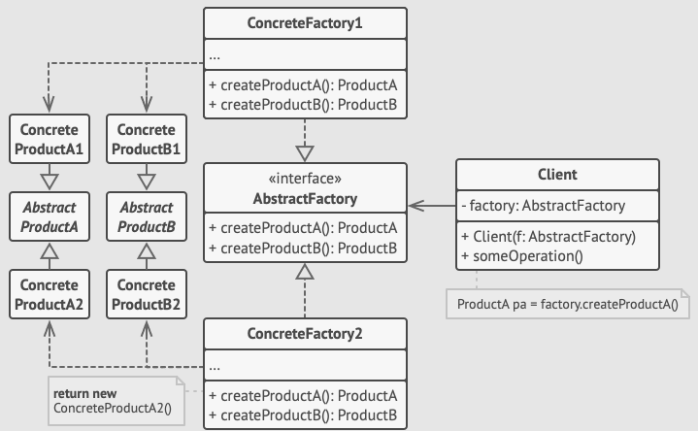



Abstract Factory: Declares methods for creating abstract products.
Concrete Factories: Implement the methods of the abstract factory to create concrete products.
Abstract Products: Interface for a family of related products.
Concrete Products: Classes that implement the abstract products.

Slide 4
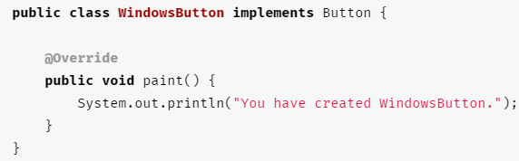
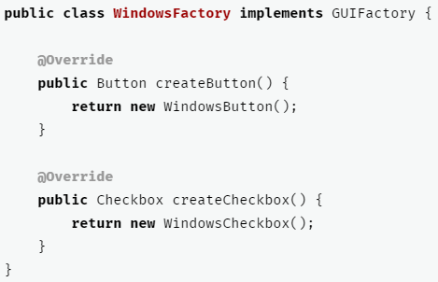
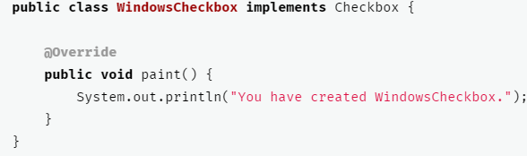
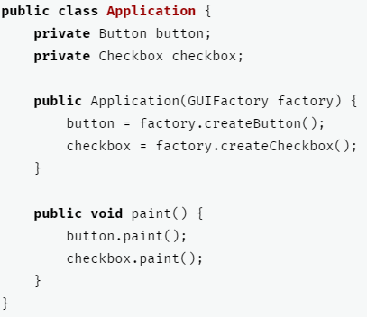


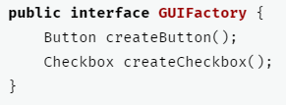
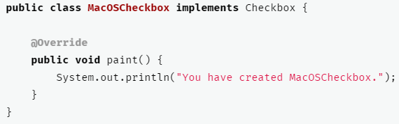
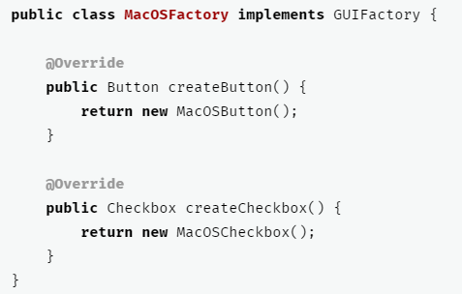
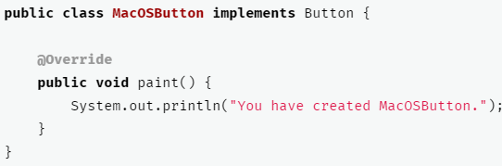

Slide 5
Benefits
Drawbacks
The products you’re getting from a factory are compatible with each other.
Promotes code flexibility and maintainability
Supports the Open/Closed Principle by allowing the addition of new products without modifying existing client code
Can lead to increased complexity, especially with a large number of product families
May require significant upfront design effort

